Slide 1
The NeXus API, Utilities and NXDL
Freddie Akeroyd
STFC ISIS Facility
for NeXus Tutorial, NOBUGS 2012

Slide 2
Introduction
Mark has covered NeXus rules
  How objects are arranged in a hierarchy
  Rules for storing objects
  Metadata e.g. units, axes
We will now cover
  How objects are written and stored in files
  Utilities for manipulating NeXus files
  The NXDL language for writing application definitions and validating file

Slide 3
The NeXus API (NAPI)
Designed to make it easier to read and write NeXus files
Hides unnecessary features / complexity of underlying file system storage commands
A uniform interface to hide knowledge of the underlying low level storage format
Enforces certain elements of the standard

Slide 4
API Overview
Written in C, but with additional language bindings (C++,JAVA,PYTHON,IDL,...)
open, close, get, put style interface
  like walking a file system tree
Includes “get next” attribute / entry calls
Also enquire array dimensions

Slide 5
Open and Close file (C API)
NXhandle fileid;
If (NXopen(“file.nxs”, NXACC_CREATE5, &fileid) != NX_OK) { error }
If (NXclose(&fileid) != NX_OK) { error }
If opening existing file, uses NX_LOAD_PATH environment variable.
“fileid” is passed to all other API functions

Slide 6
Thread Safety
The NeXus API itself is now thread safe provided each thread uses its own NXhandle
  Each thread must call NXopen separately
  Earlier non-thread safety related to error reporting
However HDF5 serialises all access, so there is no performance gain from using threads
  Would need to use parallel HDF5 (different API)
  Also requires parallel file system, MPI, MPI-IO, ...

Slide 7
NeXus C++ API
As most people here have O-O experience, the C++ API will be used for remaining examples
  NXhandle encapsulated in NeXus::File class
  C API functionality exposed as member functions
A few difference / extensions from C API
  throws exceptions on NX_ERROR conditions
  supports std::vector<type> and std::string
  can obtain a container of entry/attribute details rather than needing to iterate via “get next”

Slide 8
Create a group (C++ API)
NeXus::File nf(“test.nxs”,NXACC_CREATE5);
nf.makeGroup(“entry1”, ”NXentry”); // just create
nf.openGroup(“entry1”, ”NXentry”); // move inside
// To create and enter a group in one call use
nf.makeGroup(“sample”, ”NXsample”, true);
// now leave the groups
nf.closeGroup(); // leave sample
nf.closeGroup(); // leave entry1

Slide 9
Create a data item (C++ API)
NeXus::File nf(“test.nxs”, NXACC_CREATE5);
std::vector<int> dims;
dims.push_back(100); dims.push_back(100);
int counts_array[100][100];
nf.makeData( “counts”, NX_INT32, dims, true);
nf.putData(counts_array);
nf.putAttr( “axes”, “[px,py]”); // attribute of “counts”
nf.closeData(); // leave “counts”
std::vector<int> px; // fill px with numbers
nf.writeData(“px”, px); // make,open,put,close

Slide 10
Enhanced File Navigation
Go straight to an object and open
  openPath( “/path/to/item”)
Open the group containing an object
  openGroupPath( “/path/to/item”)
Open source group of linked dataset
  openSourceGroup()

Slide 11
Linking items
Items in a file can be linked
They appear at multiple place is the hierarchy, but take no additional space
  Like symbolic links in a filesystem
Target item may have a different name
Use openSourceGroup to open the parent group of the link target
  E.g. If you linked two_theta from NXdetector into NXdata, this would open NXdetector group for you

Slide 12


Data Linking
NXinstrument
NXsource
solid_angle[100]
NXdetector
gas_pressure[100]
two_theta[100]
NXmonochromator
counts[100]
NXdata
two_theta[100]

Slide 13
External Linking
Can create a group linked to an external URL
  Only a local file is currently supported
  nxfile://filename/path/to/group
  Also uses NX_LOAD_PATH to find “filename”
Use linkExternal() to create group
Use isExternalGroup() if you wish to test if a group is external
openGroup() works as normal

Slide 14
Iterating Through Groups (C++ API)
using namespace std;
NeXus::File nf;
typedef map<string, string> smap_t;
smap_t entries;
// navigate to somewhere
entries = nf.getEntries();
for(smat_t::const_iterator it=entries.begin(); it != entries.end(); ++it) {
cout << “Name “ << it->first <<
“ class “ << it->second << endl;
}

Slide 15
Python API
Thin binding to NeXus C API
nxs module open() returns NeXus file object
Can use strings rather than constants
  ‘r’ -> nxs.ACC_READ, ‘float32’ -> nxs.NX_FLOAT32
getdata() / putdata () use numpy array objects
NeXus class has C API functions plus extras:
  entries() returns dictionary of group contents
  attrs() returns dictionary of attributes

Slide 16
Python Example (read)
import nxs,numpy
nxfile = nxs.open(‘test.nxs’,’r’)
nxfile.openpath(‘/entry/r8_data’)
val = nxfile.getdata()
nxfile.close()
For online documentation type:
help(nxs.napi)
Or visit http://download.nexusformat.org/

Slide 17
Python API (tree)
>> Import nxs
>> a=nxs.load(“file.nxs”)
>> a.nxtree() # print out tree
>> b = a.entry1.data.total_counts # access data
>> b = a.NXentry[0].NXdata[0].nxplot()

Slide 18
Reading NeXus file with h5py
import h5py # HDF5 support
fileName = "prj_test.nexus.hdf5"
f = h5py.File(fileName, "r")
for item in f.attrs.keys():
print item + ":", f.attrs[item]
mr = f['/entry/mr_scan/mr']
i00 = f['/entry/mr_scan/I00']
print "%s\t%s\t%s" % ("#", "mr", "I00")
for i in range(len(mr)):
print "%d\t%g\t%d" % (i, mr[i], i00[i])
f.close()

Slide 19
NeXus tools
nxbrowse - CLI NeXus browser
nxsummary - create summary of nexus file
nxdiff - compare two files
nxconvert – change the low-level representation of a NeXus file (e.g. HDF5 -> XML, HDF4 -> HDF5)
nxtranslate - assembles NeXus file from other files (NeXus importer)
nxextract - convert from NeXus to ASCII and binary (NeXus exporter)
nxvalidate - validates file against definition
nxplot – generic plotter for NeXus files

Slide 20
NXbrowse
Simple command line browser with readline support
  CD, DIR, and DUMP commands
  Pressing <TAB> after typing a command or partial item name lists/completes that name

Slide 21
NXsummary
Creates a quick summary of a NeXus file
Items to be printed specified in a configuration file
Optional XML output
Supports simple transforms of items
  e.g. count, sum

Slide 22
NXdiff
Python program to compares two NeXus files
  Example of using the NeXus python API
  Type nxdiff –help for options

Slide 23
NXconvert
Changes the low level representation of a NeXus file
  e.g. HDF5 -> XML, HDF4 -> HDF5
  Type nxconvert –help for options

Slide 24
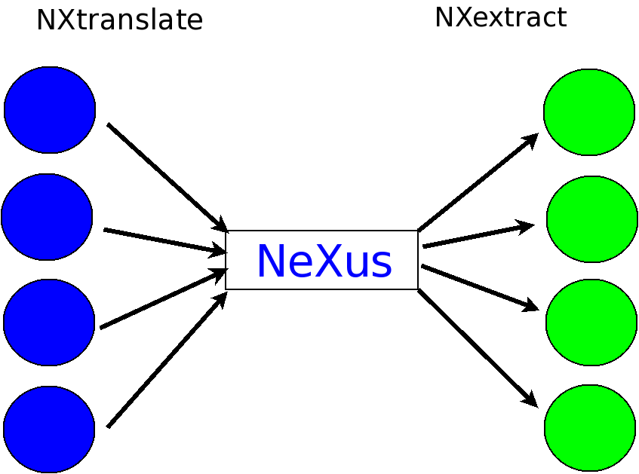

Slide 25
NXtranslate
Anything to NeXus converter (importer)
Placeholder for items specified in XML file
Calls plugins to read and insert the appropriate data files into the output
  Can handle FRM2, IPNS, SPEC, ESRF EDF, XML, binary floats/ints, ASCII column text and other NeXus files
  Easily extended by writing your own plugin

Slide 26
Example translation file
<!– simple example to insert a title from one NeXus file into another →
<NXroot>
<entry1 type=“NXentry” NXS:source=“other_file.nxs” NXS:mime_type=“application/x-NeXus”>
<value1 my_attr=“test”>this is a test</ value1>
<value2 NXS:location=“/entry3/title” />
</entry1>
</Nxroot>

Slide 27
NXextract
Exports portions of a NeXus file as binary or ASCII
Process controlled by configuration file
Built-in syntax for looping through elements
Contributed by Stephane Poirier, SOLEIL

Slide 28
NXDL – NeXus definition language
A replacement for the old Meta-DTD syntax
An XML based notation for specifying the contents of a NeXus file
Allows XML schema based tools to be used for validating both files and definitions
Documentation can easily be generated directly from NDXL files

Slide 29
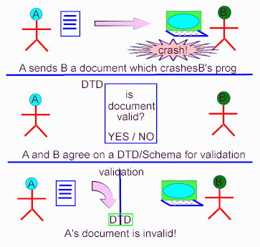
Why is Validation Important?

Slide 30
NXVALIDATE
NeXus file
XML file
(nxconvert)
Validation
NXDL Definition file
XML schema (schematron)
(xslt)

Slide 31
New Definition Format
<definition name="NXfermi_chopper" type=“group” category=“base” version=“1.0” extends="NXchopper">
<doc>Description of a Fermi chopper, possibly with curved slits.</doc>
<field name="radius" type="NX_LENGTH">
<doc>radius of chopper</doc>
</field>
<group type="NXgeometry">
<doc>geometry of the fermi chopper</doc>
</group>
…

Slide 32
Summary of New Features in NeXus 4.3
Links to external files now take advantage of native HDF5 external linking
  - External file links will be visible to any HDF5 (1.8.*) aware program.
HDF5 based files can now have multiple "unlimited" dimensions
  - Previously only one dimension was allowed
New API functions have been added to handle writing very large arrays.
  - Dimensions arrays can now be 64bit
A new python tree API has been added
A GUI java based NXvalidate program has now been added
The NeXus API now ensures thread safety
  - Even if the underlying HDF/XML library is not built that way.
A new function NXreopen() has been added
  - Create additional NXhandle objects from an existing NXhandle,
  - Removing the need to open and close data groups

